Slide 1

ZOHO ONE
IMPLEMENT

Slide 2
https://www.zoho.com/salesiq/features.html

Slide 3
ZOHO LIVE CHATS , POPUPS …

Slide 4
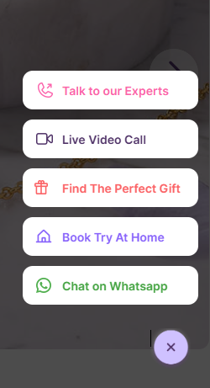
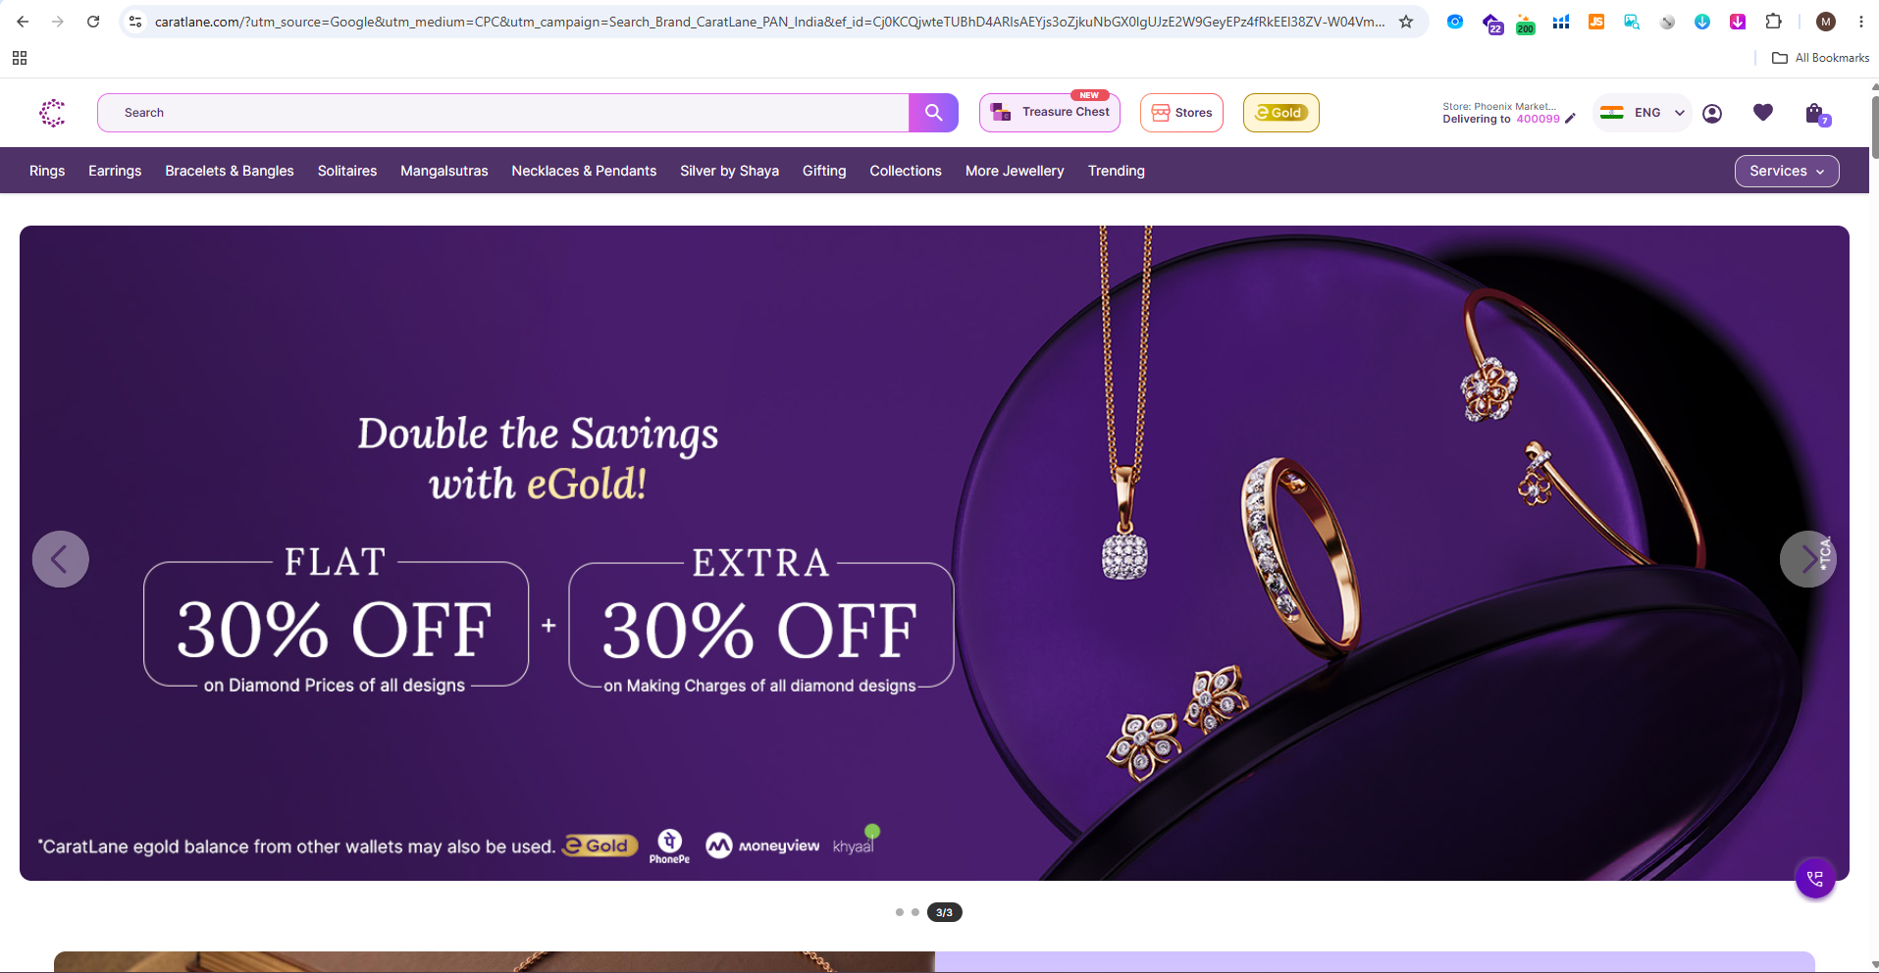
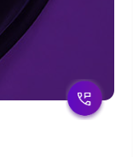
https://www.caratlane.com/

Slide 5
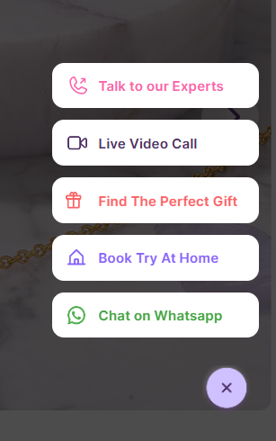
Talk to our Experts
Live Video Call
Chat With Us
Book Try At Home
Chat on WhatsApp

Slide 6
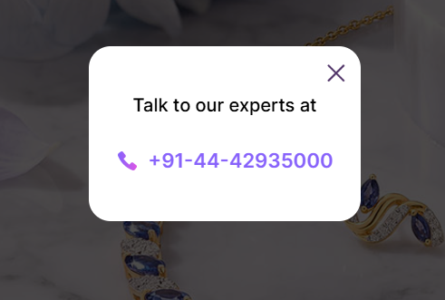
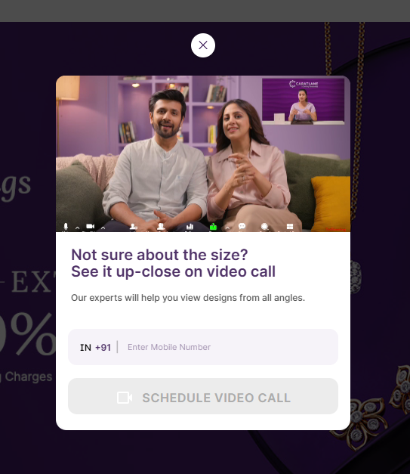
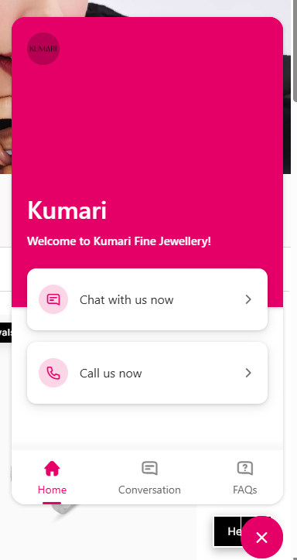

Milo Jewels
Welcome to Milo Jewels!
Chat with us Now
Talk To Our Experts
Live Video Call
Chat with us now

Slide 7
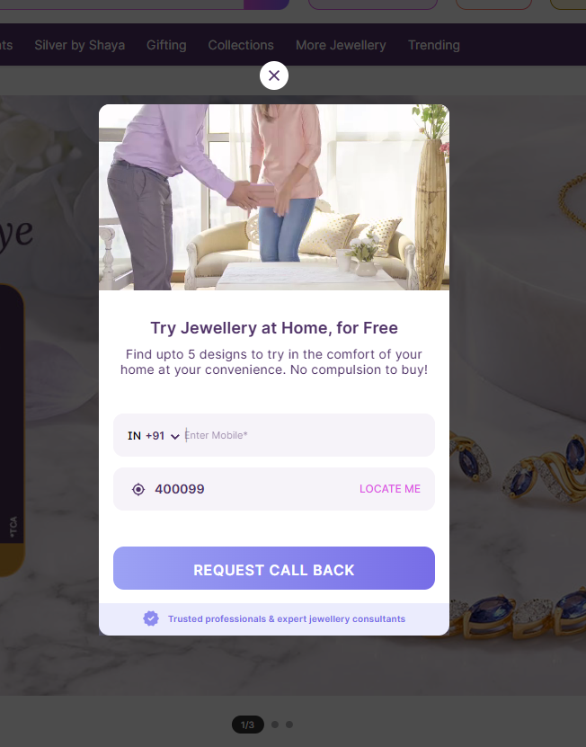
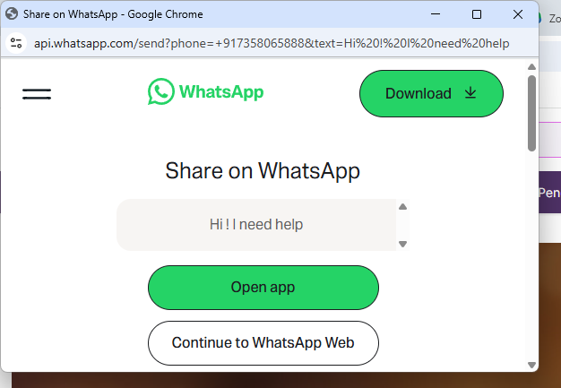
Chat On WhatsApp
Back Try at Home

Slide 8
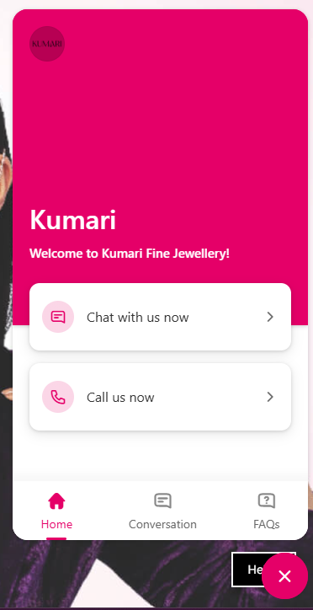
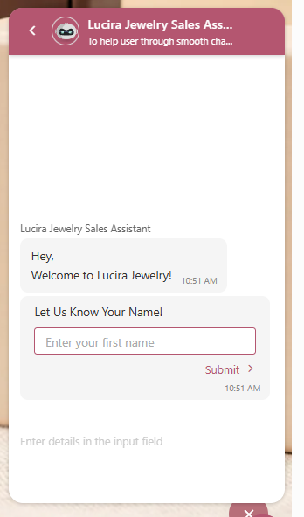
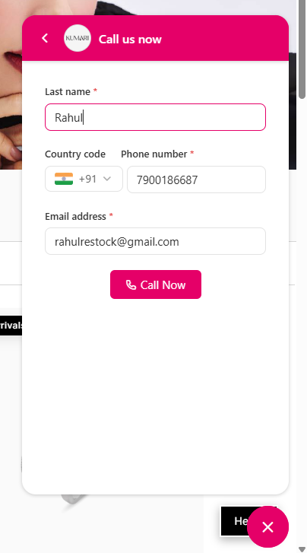
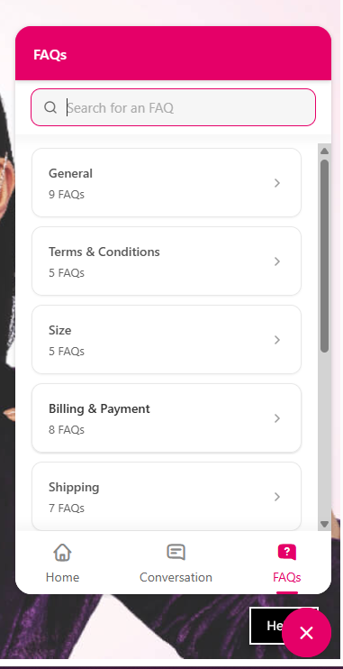
Chat with us now
Call us now
FAQs
Milo Jewels
Welcome to Milo Jewels!

Slide 9
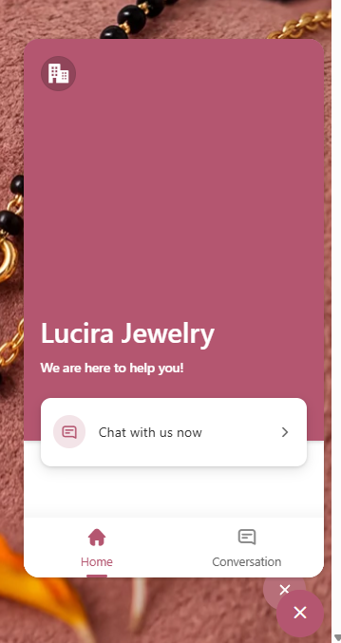

Slide 10
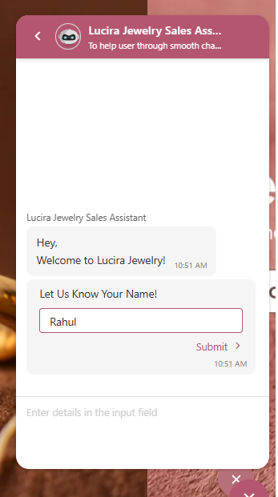
Milo jewels sales Assistant
To help user through smooth chat support journey
*Note : Replace Brand name Lucira Jewelry – Milo Jewels.

Slide 11
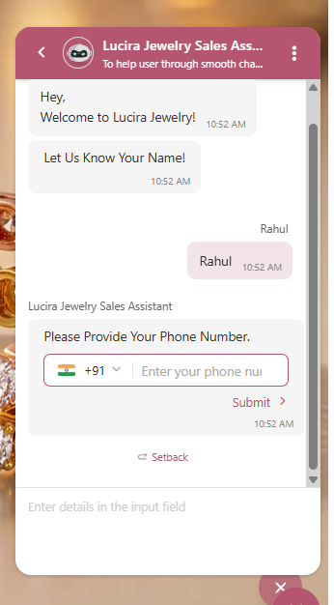
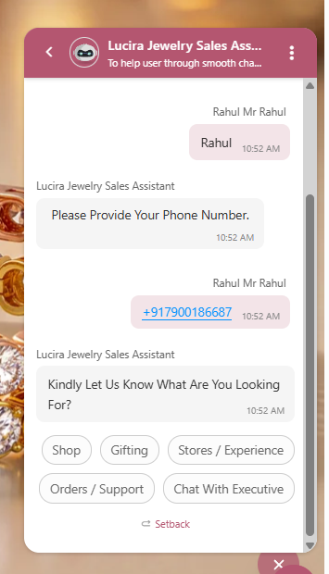


Slide 12
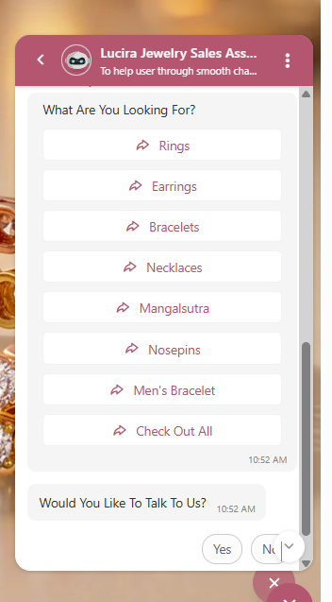

Rings
Earrings
Necklaces & Pendants
Bracelets & Bangles
Solitaire
Mangalsutra
Collection
Shop All

Slide 13
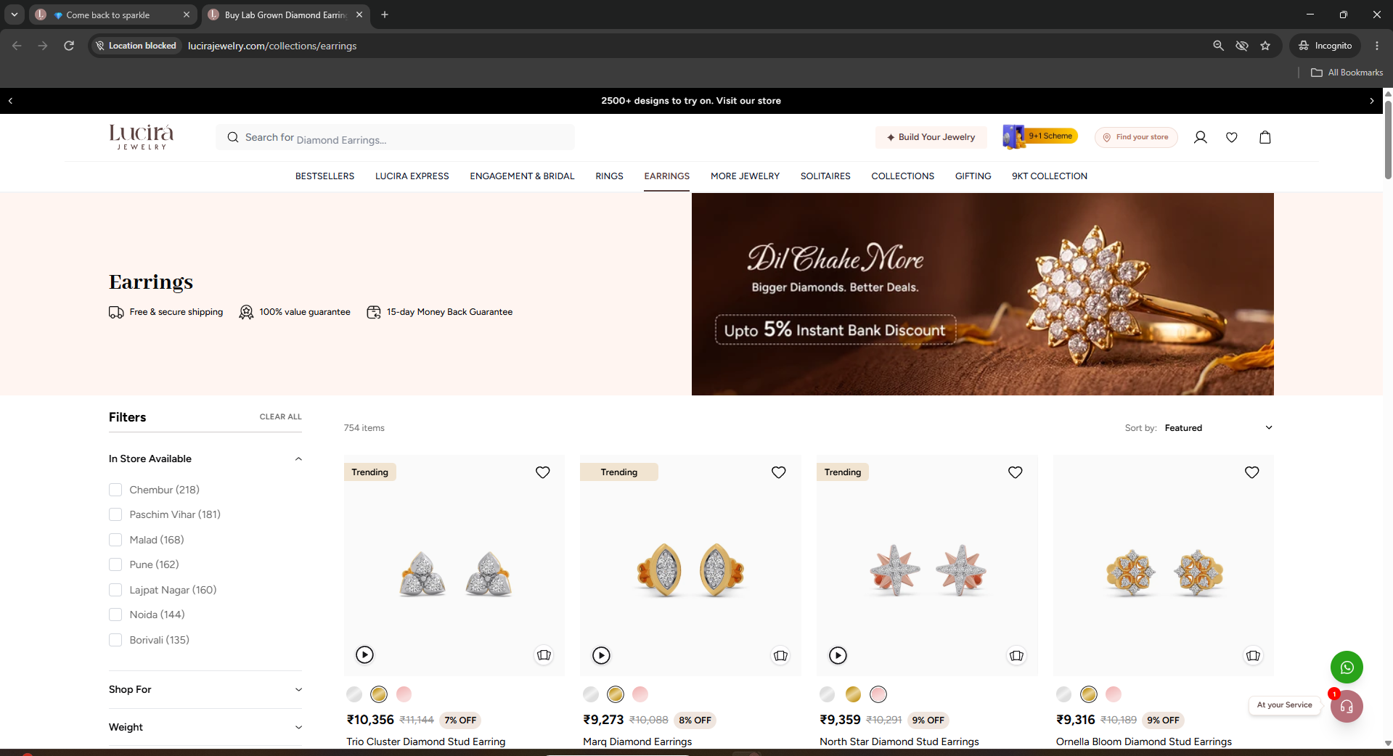
Rings
Earrings
Necklaces & Pendants
Bracelets & Bangles
Solitaire
Mangalsutra
Best Seller
Shop All
https://milojewels.com/collections/rings
https://milojewels.com/collections/earrings
https://milojewels.com/collections/necklaces
https://milojewels.com/collections/bracelets
https://milojewels.com/collections/pendant-solitare
https://milojewels.com/collections/pendant-mangalsutra
https://milojewels.com/collections/best-sellers
https://milojewels.com/

Slide 14

https://milojewels.com/collections/gifting

Slide 15
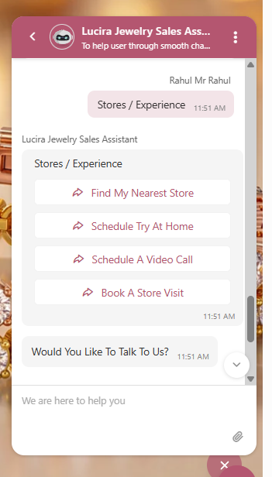

Find My Nearest Store
Schedule Try at Home
Schedule a Video Call
Book A store Visit

Slide 16
Find My Nearest Store
Schedule Try at Home
Schedule a Video Call
Book A store Visit
https://milojewels.com/pages/store-location
https://api.whatsapp.com/send/?phone
https://milojewels.com/pages/video-consultation
https://api.whatsapp.com/send/?phone

Slide 17
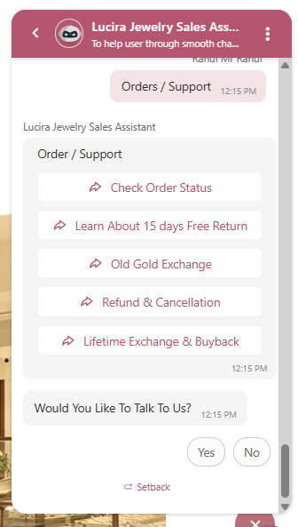

Check Order Status
Shipping Policy
Cancellation/Exchange Refund/Return Policy

Slide 18
https://api.whatsapp.com/send/
Check Order Status
Shipping Policy
Cancellation/Exchange Refund/Return Policy
https://milojewels.com/pages/shipping-policy
https://milojewels.com/pages/return-exchange
https://milojewels.com/pages/return-refund-policy

Slide 19
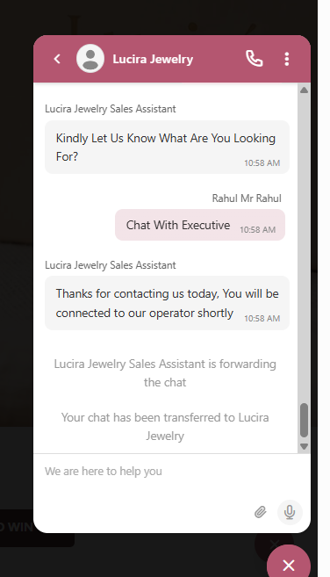


Slide 20
All Faqs Shared at word

Slide 21
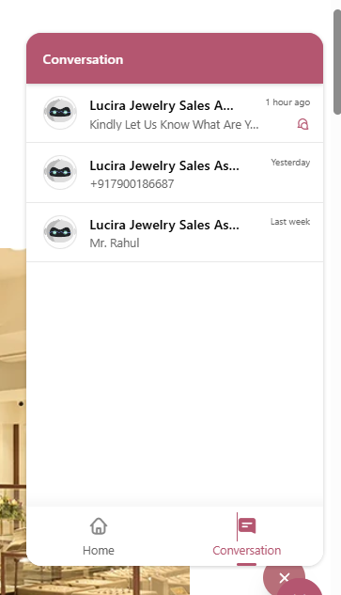
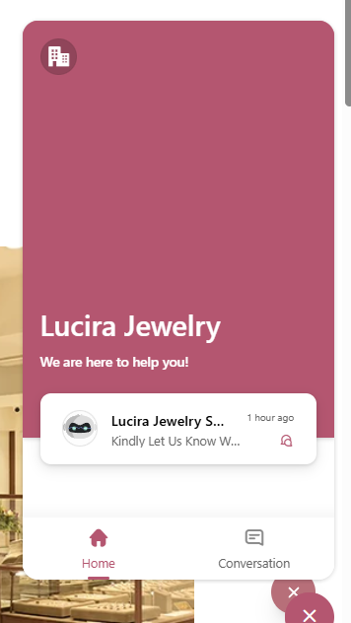


Slide 22
Thanks
Rahul Gupta
+917900186687

